Slide 1

Data analysis on Tourism Dataset
Presented by:
Geetha Potuka

Slide 2
Domain knowledge and Company Information:
1. "Trips & Travel .Com" company wants to enable and establish a viable business model to expand the customer base.
2. One of the ways to expand the customer base is to introduce a new offering of packages. Currently, there are 5 types of packages the company is offering -
1.Basic.
2.Standard.
3.Deluxe.
4Super Deluxe .
5.King.
The Marketing Department
1.Looking at the data of the last year, we observed that 18% of the customers purchased the packages.
2.the marketing cost was quite high because customers were contacted at random without looking at the available information.
Problem Statement:
1.The company is now planning to launch a new product .
2.Wellness Tourism Package Wellness Tourism is defined as Travel that allows the traveler to maintain, enhance or kick-start a healthy lifestyle, and support or increase one's sense of well-being.
Objectives:
This time the company wants to harness the available data of existing and potential customers to make the marketing expenditure more efficient.

Slide 3
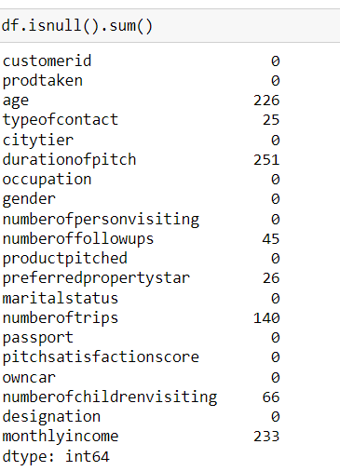
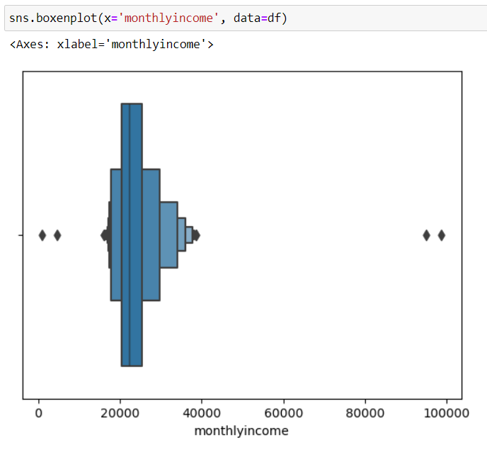

Missing Values V/S Outliers Treatment
Missing values for all columns were filled with the mode, while missing values for the income column were filled with the median
Outliers were detected using a boxen plot and were addressed by removing high-income values.

Slide 4
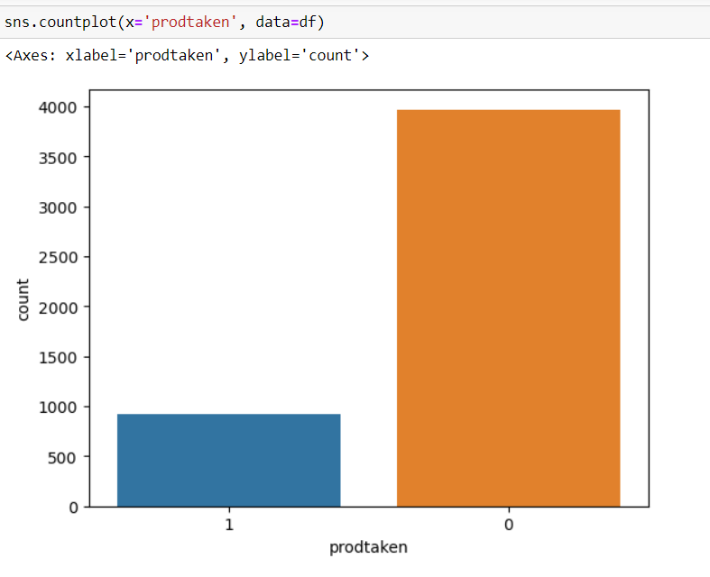
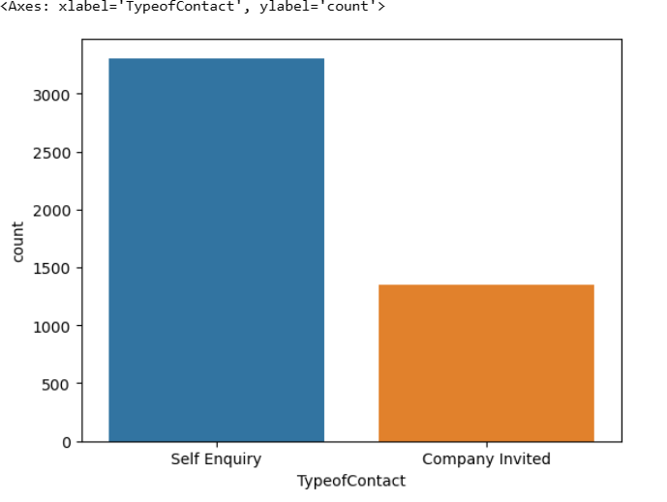
Univariate analysis
product-Taken
Type-of-contact
Insights:
0-indicates the product is not purchased
1-indicates the product is purchased
Therefore, customers are not purchasing the product.
Insights:
People mostly contact to company by self Enquiry
less people company invited link

Slide 5
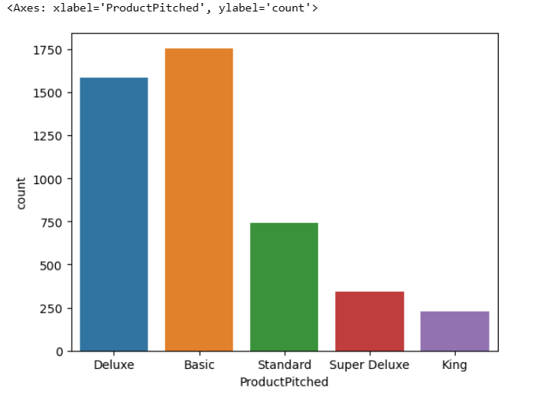
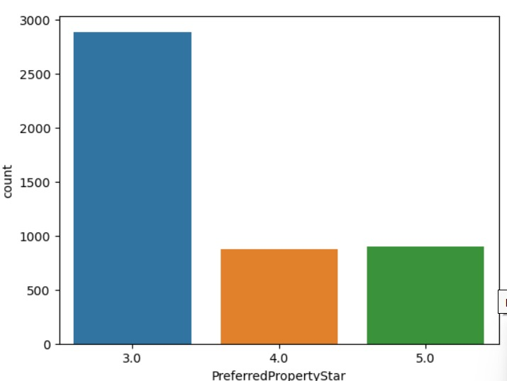
Packages
Rating
Insights: mostly rating is 3.0 whereas rating 4,5 are low
Insights: we have 5 packages mostly basic and Deluxe are taking highly

Slide 6
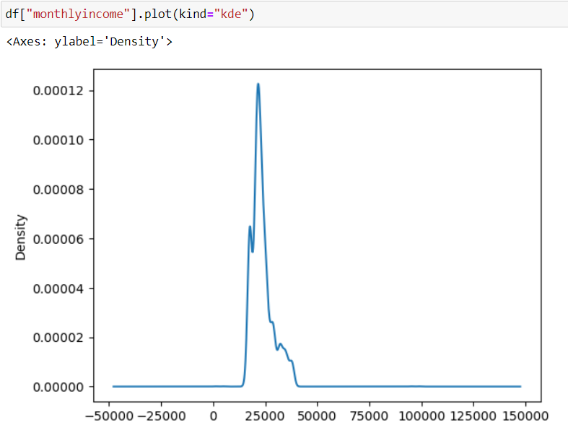
Income
Insights:It is right-skewed, indicating the presence of outliers.
Skewness is greater than 1.
The mean is greater than the median.
Kurtosis is also higher.
Therefore, it follows an exponential distribution.

Slide 7
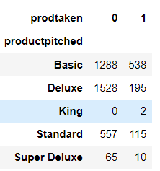
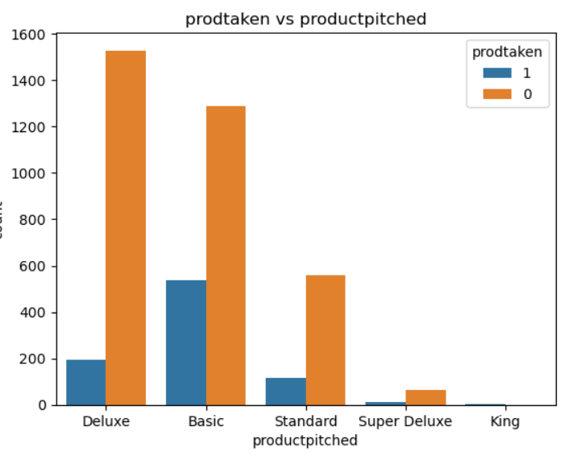
Relationship between product Taken and product pitched
Insights: There are five types of rooms, with very few people opting for basic and deluxe accommodations. On the other hand the super deluxe room was largely rejected by many individuals.

Slide 8
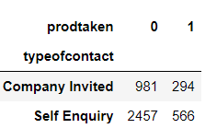
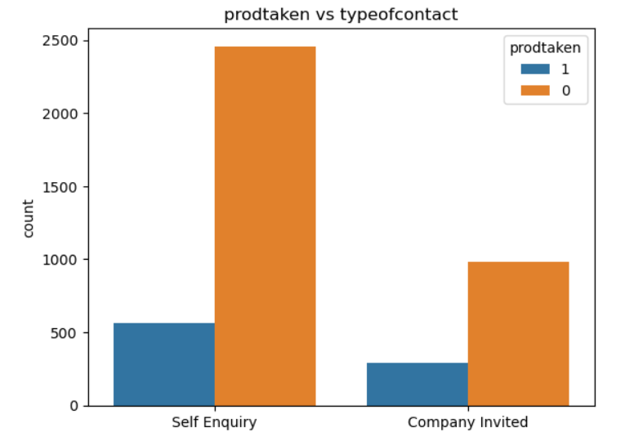
Relationship between product Taken and type of
contact
Insights: mostly product are taken by self Enquiry
The majority of customers who purchased the product did so through self-enquiry, while, at the same time, a higher number of customers who declined the product also came from self-enquiry.

Slide 9
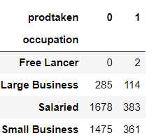
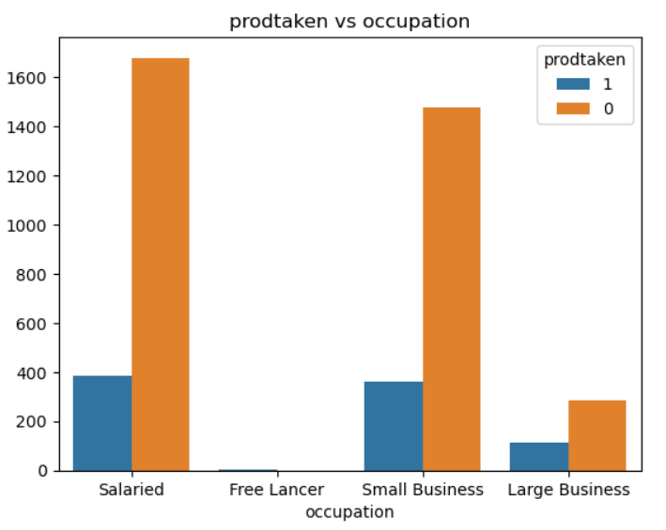
Relationship between product Taken and
Occupation
Insights: Customers who purchased the product were high from the salaried and small business categories, while the product faced a higher rate of rejection among salaried individuals.

Slide 10
Recommendations based on insights:
1.Basic and Deluxe products have lower prices, and most customers tend to purchase these items. Therefore, in order to achieve a balanced distribution of sales across all products, we should consider reducing the prices of the Super Deluxe and King products.
2.To improve our rating, we must understand our customers' requirements. By fulfilling their needs based on these requirements, we can then achieve a higher rating.
3.We need to provide accurate information about the hotel on the website, including a contact number for guests to reach out to.
4.we can give advertisements through social media to reach the people
Conclusion:
Personalized marketing takes into account customer preferences, travel history, and their interests in well-being. This approach involves crafting customer-specific messages and offers that emphasize the advantages of Wellness Tourism. After launching the Wellness Tourism program, gather feedback from customers. This feedback will assist us in improving the program's strategies

Slide 11


